Slide 1
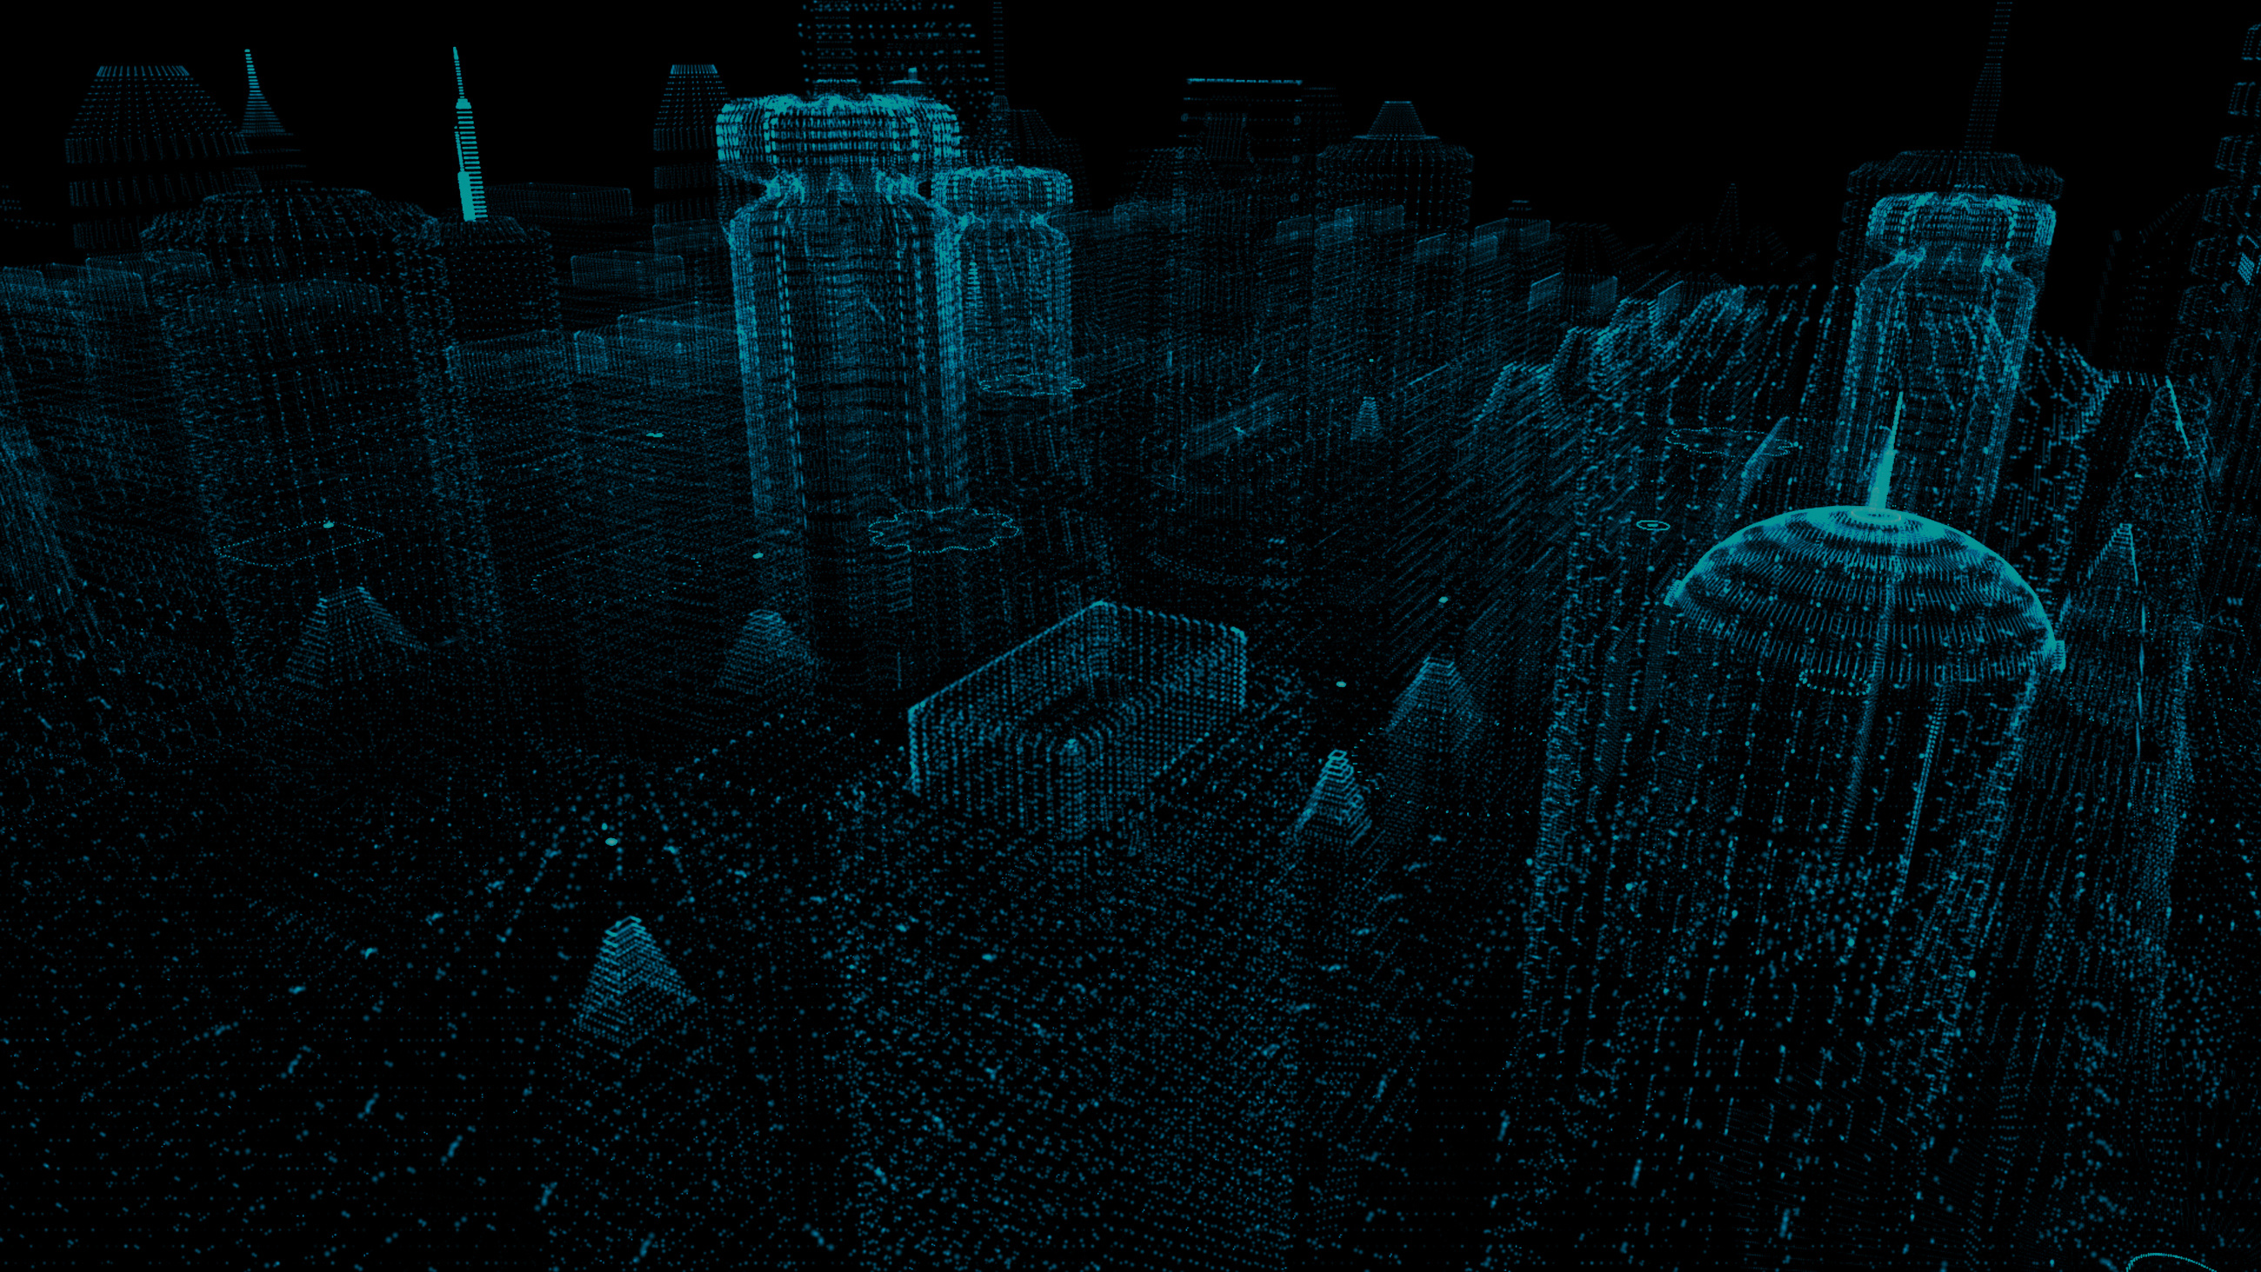


SENSE WAVE
A Smart Hazard Detection for Safer Roads and Walkways

Slide 2

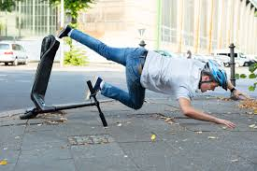



Tired of Tripping and Falling?

Slide 3

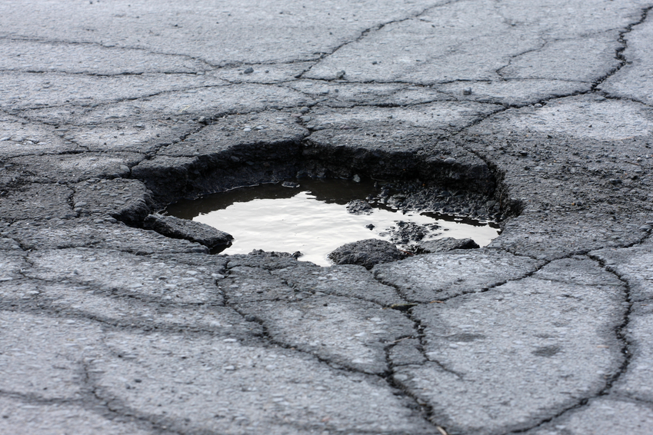
WHO ARE WE?
SenseWave is an Augmented Reality Program that uses video feed detection to identify anomalies like potholes, uneven terrain, and environmental hazards.
It is a safe guard for cyclists, the disabled, and drivers to report pot holes they’ve come across.
The data for the reports will then be collected and distributed to the nearest cities street maintenance department.
OUR MISSION
⚠️ POTHOLE DETECTED! ⚠️
Our mission at SenseWave is to create safe walkways, roads, and to accessiblize terrain in the day to day life.
We strive for our users to be able to use our tool on the go, reporting terrain issues and safeguarding our roadways. Their diligent efforts will help guide other users around and to be wary of the reported areas.
We also aim for cities to use SenseWay as a path to keep their roads clear of terrain issues.

Slide 4
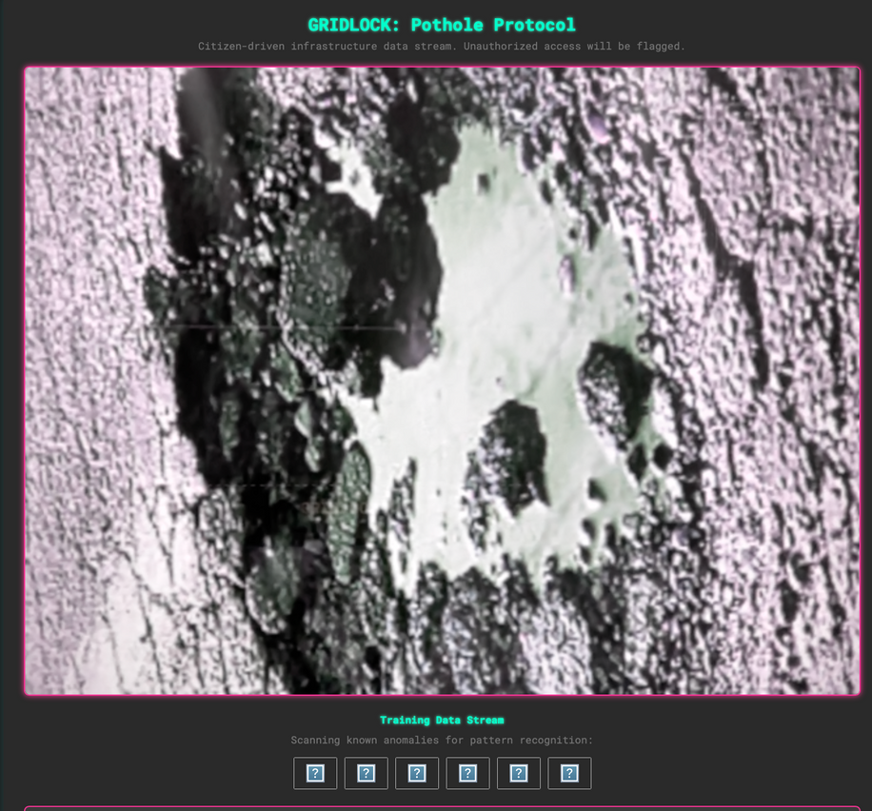
SENSEWAVE
The Languages: We built the demo using three core web languages:
HTML: The structure of our app.
CSS: The cyberpunk styling.
JavaScript: The interactive logic.
The "AI": The app's intelligence is a simulated model built in JavaScript. We trained it with pictures and descriptions you gave us to recognize grainy textures, water, and unique pothole shapes. This logic helps it avoid being confused by faces or shadows.
How it Works: The camera acts as a sensor. When it detects a pothole, it generates a warning and uses your device's geolocation to capture the exact location.

Slide 5
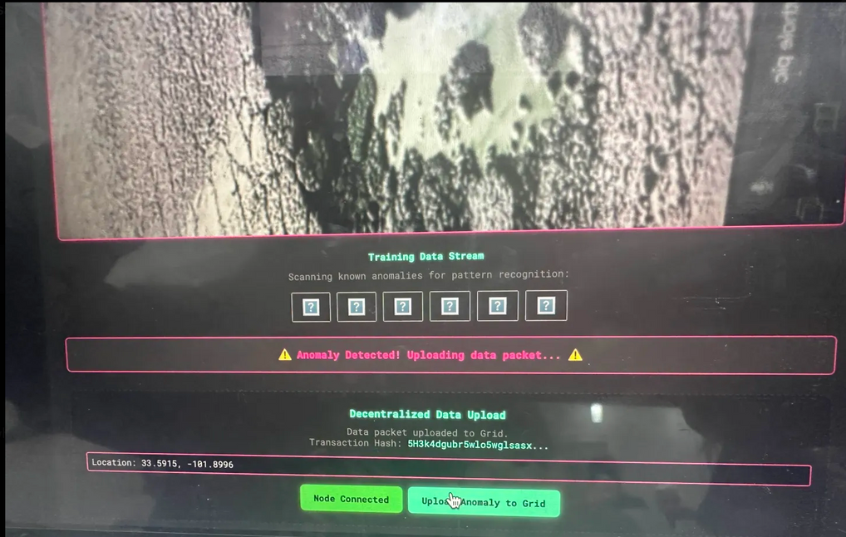
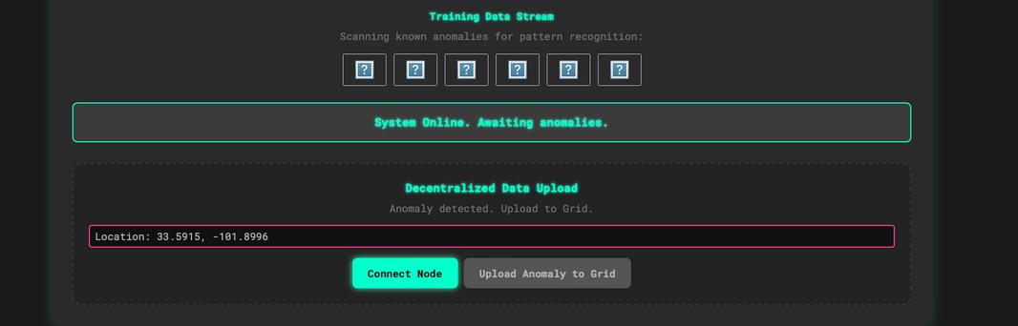
SALONA BLOCKCHAIN
The Blockchain
Solana: We used the Solana blockchain to store the pothole reports. This ensures the data is decentralized, tamper-proof, and accessible to anyone—like a city maintenance department—without a central authority.
The Result: The demo shows a complete, end-to-end process: a pothole is detected, its location is recorded, and the data is securely transmitted to a public ledger on the blockchain.

Slide 6
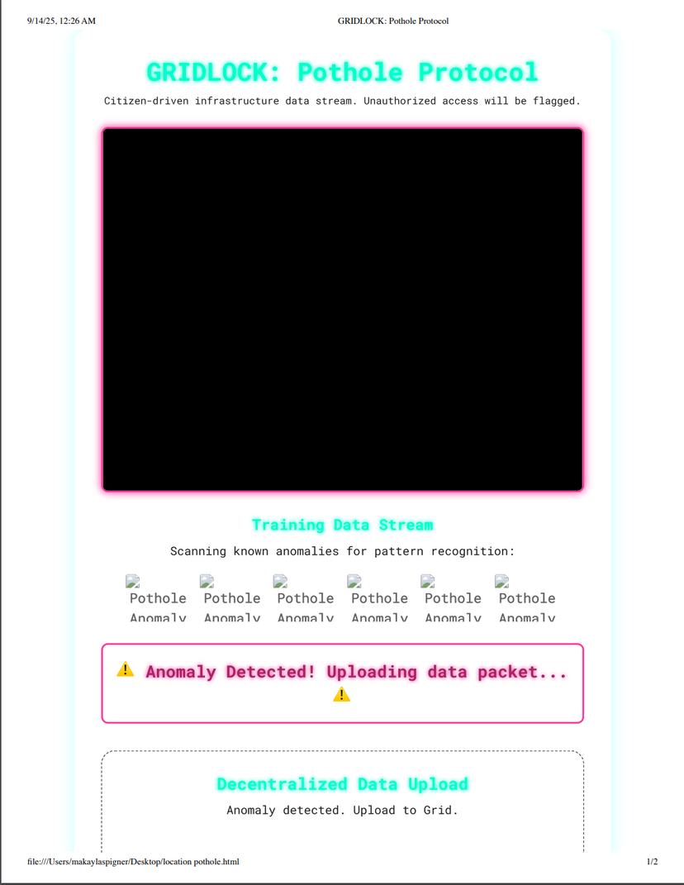
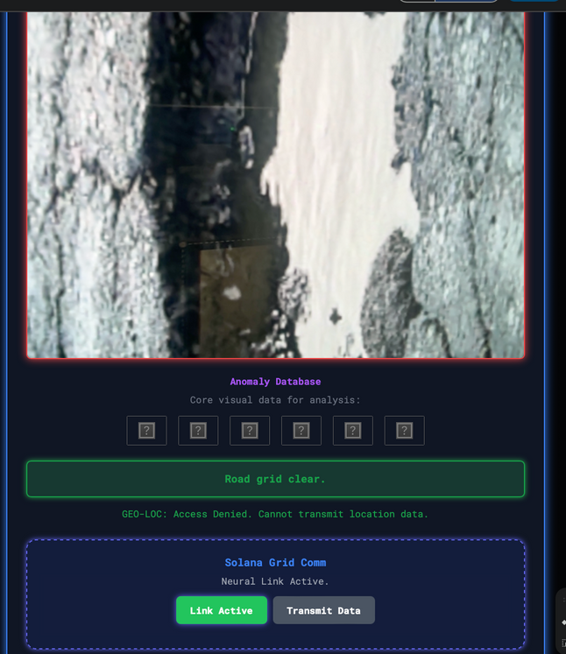
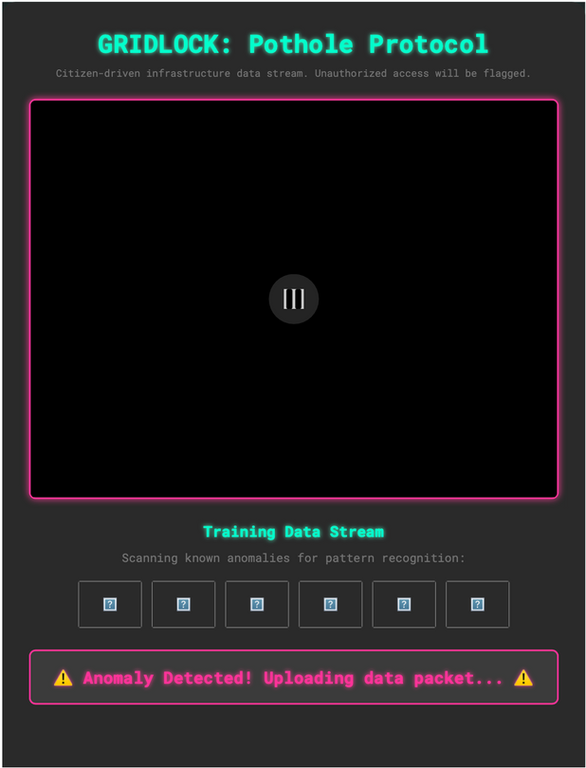
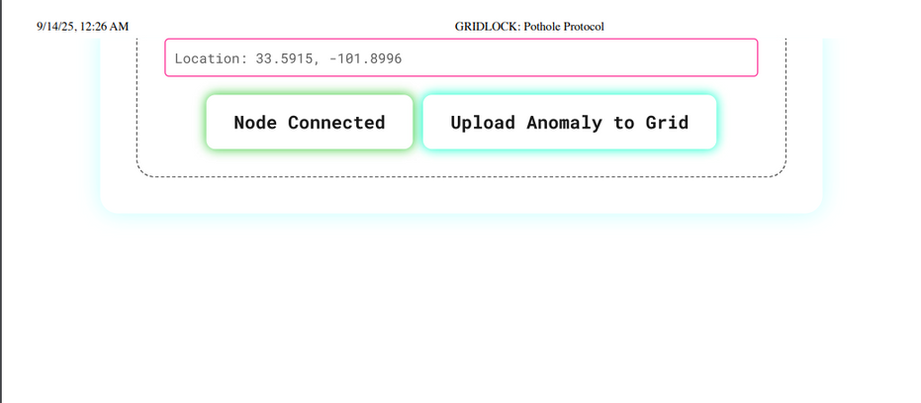
PROTOTYPE

Slide 7

INITIAL STEPS
Why Augmented Reality?
We chose AR because it's the fastest way to get critical information to a user. It overlays warnings directly onto the road, making them impossible to miss.
Our Plan
We started with a multi-language approach using C#, Python, and Unity to build a robust system.
The Demo
Our Challenge: We faced technical issues linking our code with Unity, so we pivoted to a web-based demo for a reliable presentation.

Slide 8
APP INTEGRATION
Unity Hub
Integrating Unity Hub was a simple feat at first glance, but we quickly realized the preparation we would need to correctly portray our app through the system.
Setting up the Unity Hub project, we used the AR Mobile template as a foundation for our augmented reality.
We also integrated LiveShare in VSCode so the whole team could access the code real time.
Coding
Our initial concept used a C# script within Unity to manage the camera and user interface. This script would send live video frames to a Python server.
The Python server would then run an AI model to analyze the images for potholes and send a simple signal back to C# to trigger an on-screen warning. This modular approach separated the front-end user experience from the back-end AI logic.

Slide 9
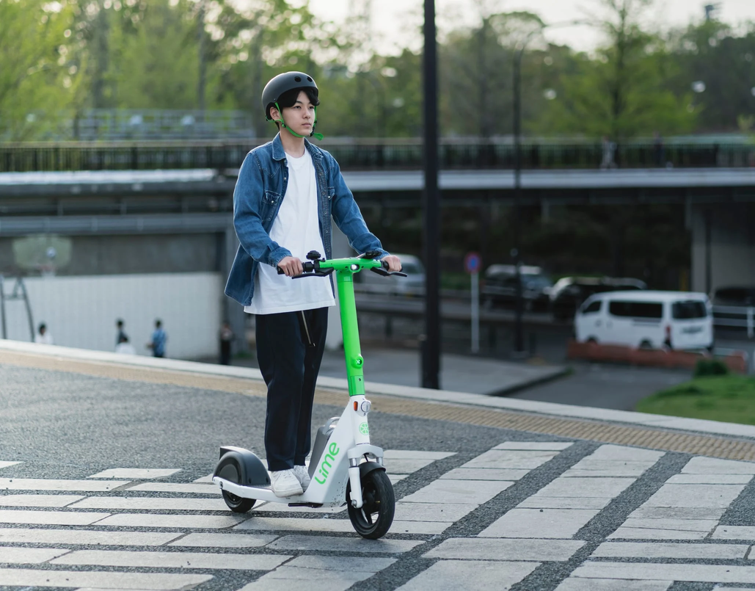
DATABASE BUILDING
Adding cameras to the Lime Scooters on Campus
Using information gathered by self-driving vehicles like Tesla and Waymo.
Accepting User reports from pictures they take with location information
Create a Database over time to create more accurate AI Models for future usage.

Slide 10
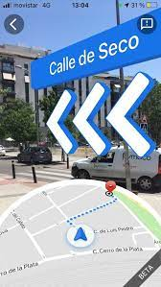
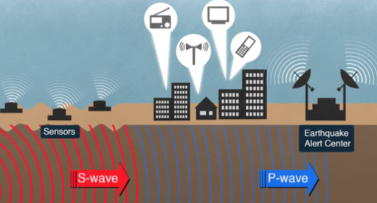
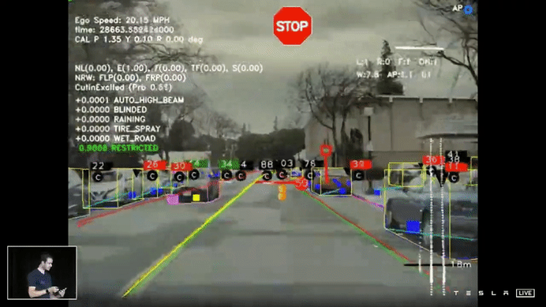
FUTURE PLANS
Incorporate this technology into navigation systems, as well as Tesla and other self-driving vehicles
Use this technology to help with the prioritization of construction projects
Eventually, it can work hand in hand with GIS information to predict sinkholes and high-impact areas during earthquakes
Voice to Text for visually impaired people
Integration with Google Maps

Slide 11
THANK YOU!

